Slide 1
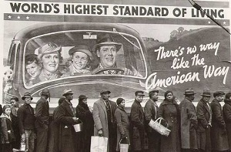
Capitalism- The American experience 1907-1941
Modern History ATAR- Unit 1, elective 7
https://www.youtube.com/watch?v=qqg_HUjxWe8&t=155s

Slide 2
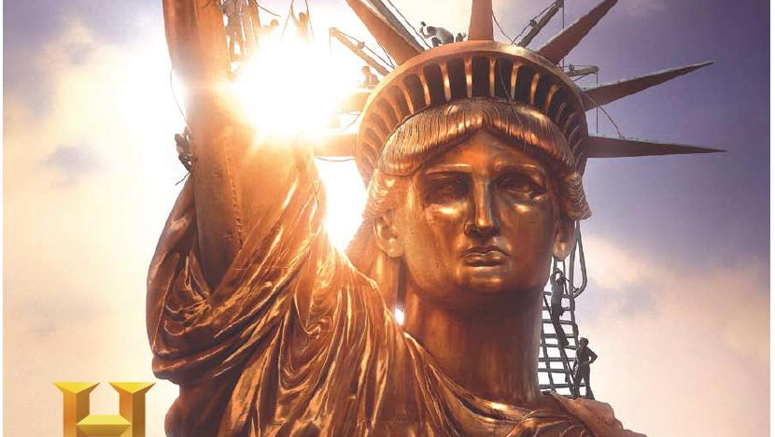
The Story of US

Slide 3
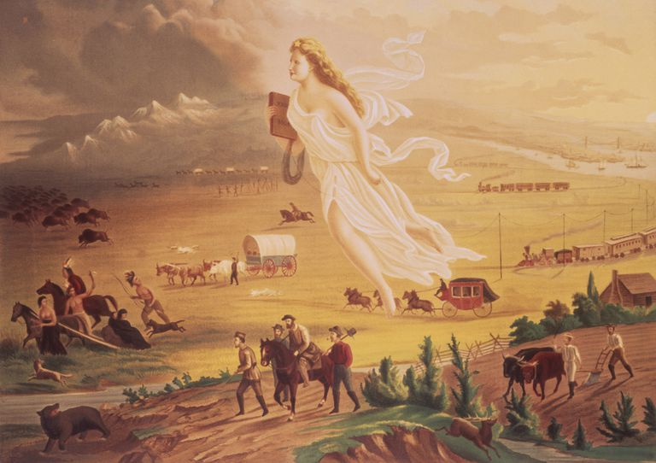
Manifest Destiny
The idea that the United States was destined by God to expand and spread democracy and capitalism across the Northern American continent.

Slide 4
The main causes of the rise of capitalism in the USA, including the expansion of the railways; post-Civil War reconstruction; immigrant labour; discovery of oil; and mass production.
What is capitalism?
How did capitalism develop in America (causes)?
Who where the key individuals involved in the rise of capitalism?
What was their role and impact?

Slide 5
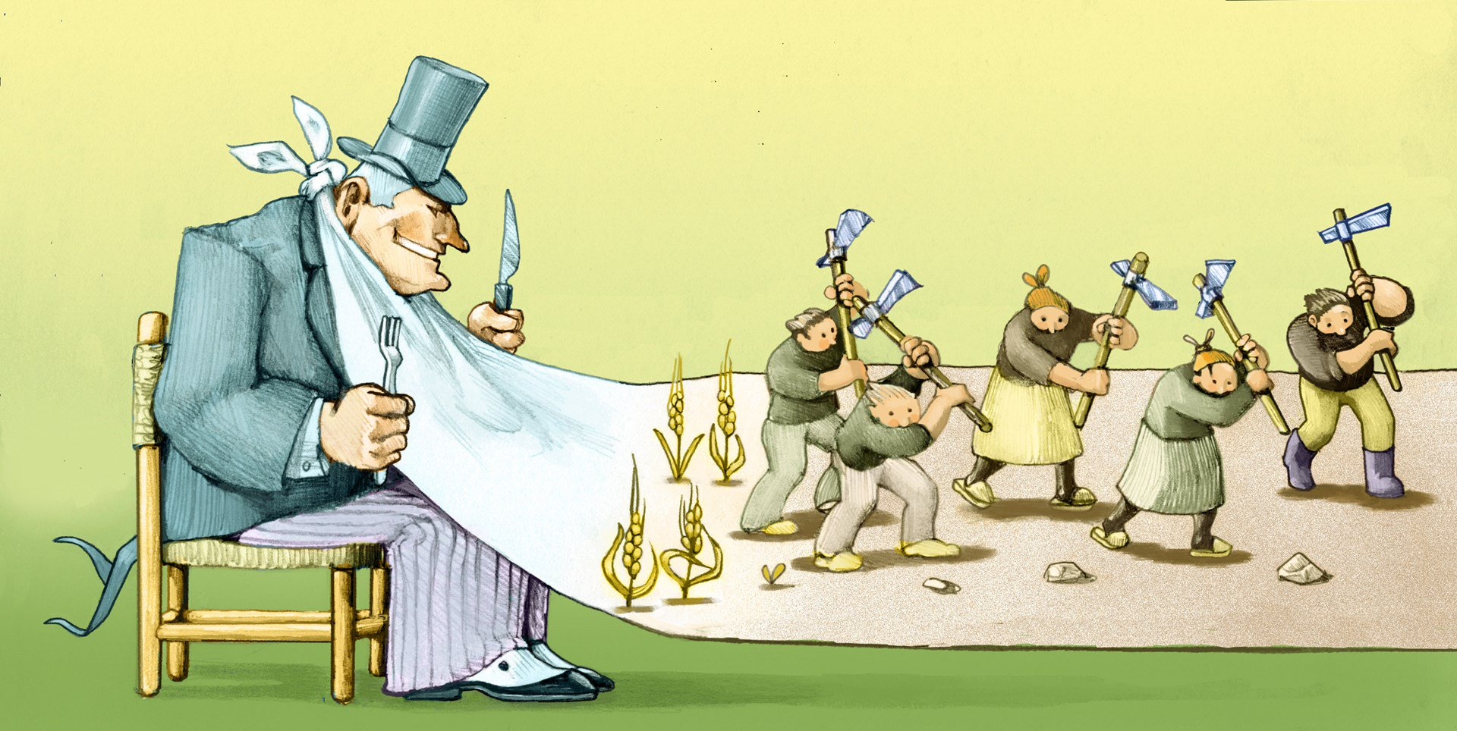
What is capitalism?

Slide 6
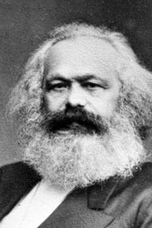
Capitalism
This term was first coined by Karl Marx to describe a system in which a small group of people own large amount of money, land, resources. It puts all the economy is the hands of wealthy business people with the only aim of maximising profits.
(Quora, 2014)

Slide 7
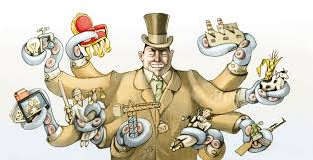
Capitalism is not just an economic system it is a philosophy (way of thinking). It is a fundamental belief that the wealthy deserve their wealth and that this wealth entitles them to a privileged position. Capitalism is an economic and political system in which a country's trade and industry are controlled by private owners for profit, rather than by the state.

Slide 8
An economic and political system in which a country’s trade and industry are controlled and owned by private individuals.
In a capitalist economy the market, not the state (government), determines the price of commodities.
Workers sell their labour to employees in return for wages.
Producers sell and trade goods for the best profit.
Private ownership is a key feature of capitalism.
(Mirams, 2015)

Slide 9

To make money! Maximise profits! “Greed is good!”

Slide 10
Economic systems
Capitalism - An economic system based on the “Survival of the fittest”.
Socialism – An economic system based on “You get your share no matter what your contribution is”.
Communism – An economic system based on “You put in your fair share, you get your fair share”.

Slide 11
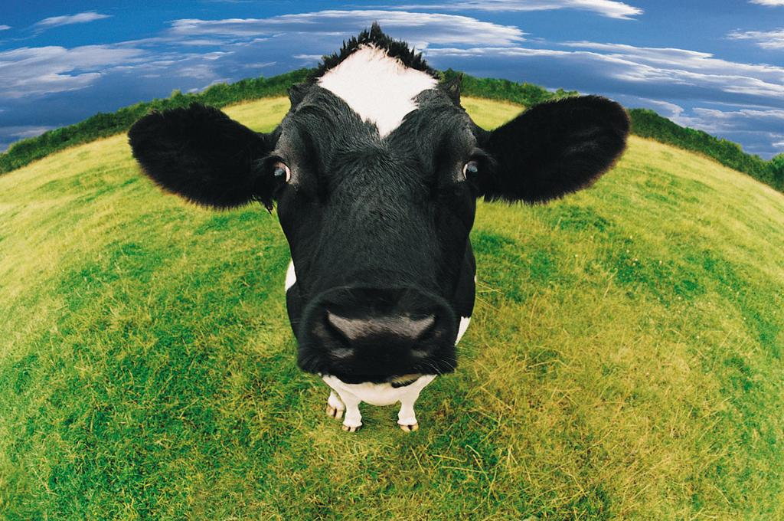
SOCIALISM
You have 2 cows.
You give one to your neighbour.
COMMUNISM
You have 2 cows.
The State takes both and gives you some milk.
FASCISM
You have 2 cows.
The State takes both and sells you some milk.
NAZISM
You have 2 cows.
The State takes both and shoots you.
TRADITIONAL CAPITALISM
You have two cows.
You sell one and buy a bull.
Your herd multiplies, and the economy grows.
You sell them and retire on the income.

Slide 12
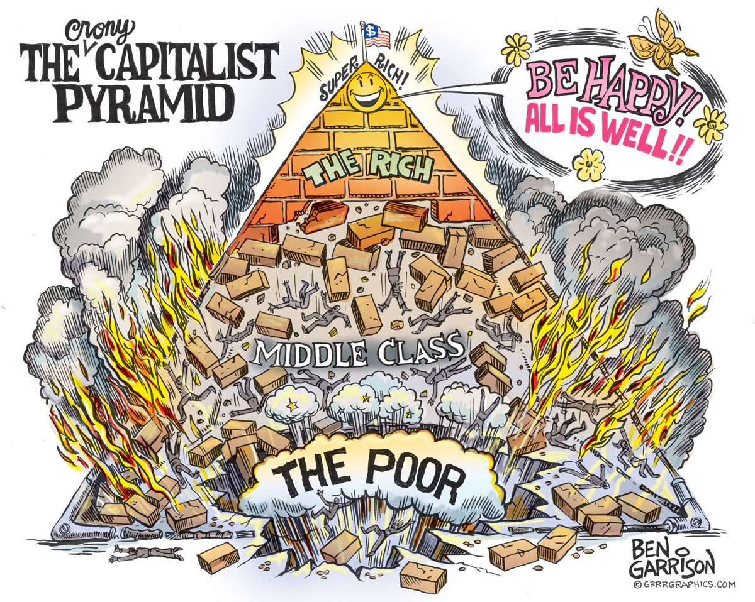
How did capitalism develop in America (causes)?

Slide 13
The main causes of the rise of capitalism in the USA, included the expansion of the railways; post-Civil War reconstruction; immigrant labour; discovery of oil; and mass production.

Slide 14
The Railways
1st Railway- 1828 (Ballimore and Ohio railroad)
Transcontinental railroad- Central Pacific and Union Pacific (1869)- travel across country.
Railroading became a highly profitable business venture.
Tens of thousands of Irish and Chinese labourers laid the track.
As the railroad industry grew, it became filled with corrupt practices. Unhindered by government regulation, railroaders could turn enormous profits using any method to get results, however unethical.
Moreover, tycoons such as the Vanderbilt's were notorious for their lack of regard for the common worker. Although some states passed laws to regulate corrupt railroads, the Supreme Court made regulations on a state level impossible with the 1886 Wabash case ruling, which stated that only the federal government could regulate interstate commerce.

Slide 15
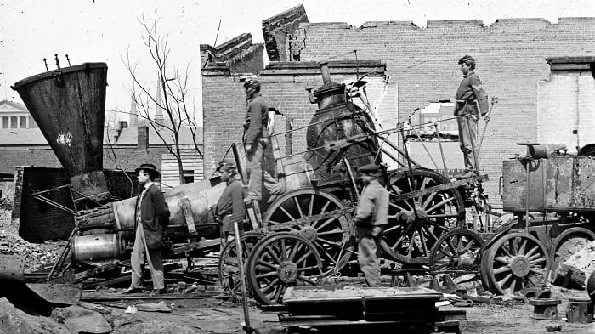
Post Civil war reconstruction
American Civil War 1861 –1865
In the twelve years after the Civil War—the era of Reconstruction—there were massive changes in American culture, economy, and politics. These were the years of the “Old West,” of cowboys, Indians, and buffalo hunts, of cattle drives, railroads, and ranches. It was also the beginning of the “Gilded Age” in the North, the age of big fortunes, enormous businesses, struggle over labor unions, and the burgeoning of cities filled with immigrants, all of it given an air of desperation by the largest economic depression in United States history beginning in 1873. The events in the West and the North interwove with those in the South, where the central struggles of Reconstruction unfolded.

Slide 16
Immigrant labour
Immigrants entered the United States through several ports. Those from Europe generally came through East Coast facilities, while those from Asia generally entered through West Coast centres. More than 70 percent of all immigrants, however, entered through New York City, which came to be known as the "Golden Door." Throughout the late 1800s, most immigrants arriving in New York entered at the Castle Garden depot near the tip of Manhattan. In 1892, the federal government opened a new immigration processing centre on Ellis Island in New York harbor.
Once settled, immigrants looked for work. There were never enough jobs, and employers often took advantage of the immigrants. Men were generally paid less than other workers, and women less than men. Social tensions were also part of the immigrant experience. Often stereotyped and discriminated against, many immigrants suffered verbal and physical abuse because they were "different."

Slide 17
Immigrant Labour
Between 1850- 1914 over 40 million people left Europe to migrate to America.
The population of the country increased by about 27 million people, from about 49 million in 1880 to 76 million in 1900. Before 1880 the immigrants came largely from Western Europe and China. In the period between 1860 and 1900 as a whole, Germans comprised 28 percent of American immigrants; the British comprised 18 percent, the Irish 15 percent, and Scandinavians 11 percent. Together they made up 72 percent of the total immigration. At the end of the century, the so-called “New Immigration” signalled the rise of southern and eastern Europe as the source of most immigrants to America.
Minimum wage was kept low.
Working and living conditions for the poor were unsanitary and unsafe.
Little protection through the law.
Inequality in health, education and employment (Only 5% of eligible students attended high school in 1900)
Little political power.

Slide 18
Discovery of oil
Although there was very little need for oil prior to the Civil War, demand surged during the machine age of the 1880s, 1890s, and early 1900s. Seemingly everything required oil during this era: factory machines, ships, and, later, automobiles.
The biggest names in the oil industry were John D. Rockefeller and his Standard Oil Company—in fact, they were the only names in the industry. Rockefeller used horizontal integration, essentially buying out all the other oil companies so that he had no competition left. In doing so, Rockefeller created one of America’s first monopolies, or trusts, that cornered the market of a single product.
The Standard Oil Company, by 1899, was a holding company which controlled the stock of many other companies. The capital was $110 million, the profit was $45 million a year, and John D. Rockefeller's fortune was estimated at $200 million. Before long he would move into iron, copper, coal, shipping, and banking (Chase Manhattan Bank). Profits would be $81 million a year, and the Rockefeller fortune would total two billion dollars.

Slide 19
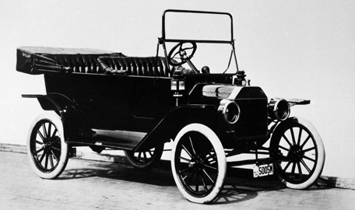
Mass production
The manufacture of goods in large quantities by machinery and by use of techniques such as the assembly line and division of labour.
By 1883, the Singer Manufacturing Company sold over 500,000 sewing machines.
Although ideas of mass production existed in many industrialised nations dating back to the eighteenth century, Henry Ford refined the idea in the early twentieth century with the mass production of cars.
Henry Ford's determination to make Model T’s and only Model T’s helped in the development of mass production techniques based on the moving belt assembly line.
Mass production lowered prices for consumers, but relegated workers to low-skill, mind-numbing jobs.
What is the legacy of these developments in production?

Slide 20
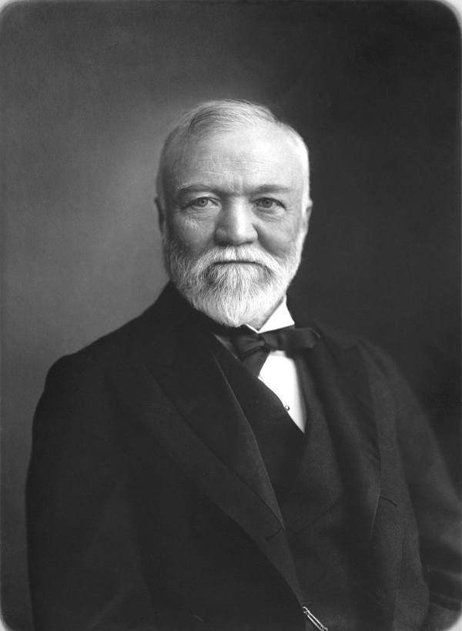
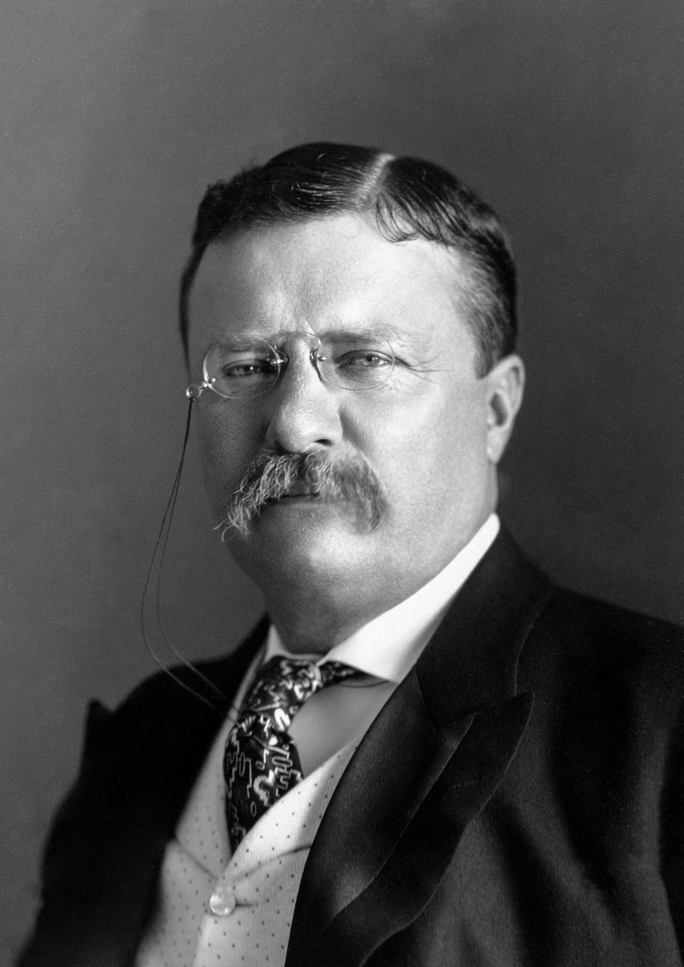
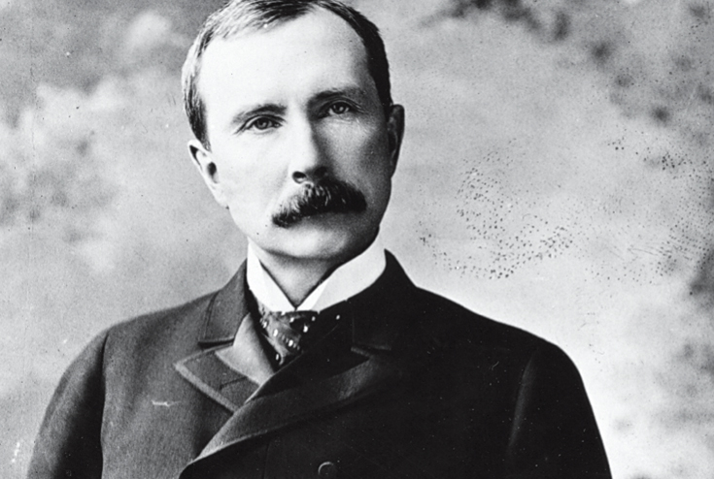
Who where the key individuals involved in the rise of capitalism?

Slide 21
Key Individuals- brief overview.
Andrew Carnegie - Expanded the steel industry making steel cheap through mass production; owner of the Carnegie Steel Company in Pittsburgh; used vertical integration to maintain market dominance, gave away 90% of fortune- called on rich to improve society.
John D. Rockefeller - Founder of the Standard Oil Company; used horizontal integration to effectively buy out his competition; first US business trust; revolutionised petroleum industry, philanthropist.
Theodore Roosevelt - 26th U.S. president; launched a collection of progressive domestic policies known as the ‘Square Deal’; youngest president at 42; involved in ’trust busting’ and regulation of industry.

Slide 22
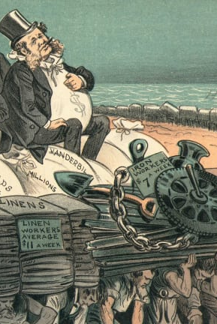
Reasons for America’s second industrial revolution (End of Civil War to the beginning of the 20th century.) Also called ‘The Gilded Age’
Lots of natural resources
Increased population- between 1860- 1900 the population went from 31.5 million to 76 million. This then stimulated demand.
14 million people migrated to US.
Improved transport systems (canals – railways)
Technological innovations improving communication and production e.g. cheaper cost of steel.
Increased capital investment in industry.
Level of government assistance

Slide 23
Gilded Age
The Gilded Age was an era of rapid economic growth, especially in the North and West. As American wages were much higher than those in Europe, especially for skilled workers, the period saw an influx of millions of European immigrants.
America's economy grew by more than 400% between 1860 and 1900.
"Titans of Industry" like John D. Rockefeller, Andrew Carnegie, and J.P. Morgan built monopolies and revolutionised business practices
Laissez faire ideology called for little or no government regulation of economic affairs.
America's cities exploded. By 1900, America's 30 million city dwellers represented 40% of the American population—up from 20% in 1860.
About half of these new urban residents were immigrants, the vast majority of them from Europe.

Slide 24
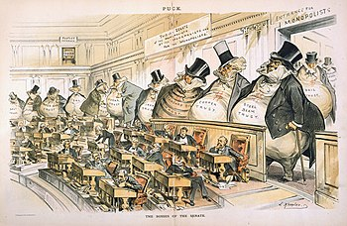
Gilded Age (contd.)- The period's label, "Gilded Age," comes close to capturing the juxtaposition of enormous wealth alongside crushing poverty.
The courts weakened unions by insisting that employers had a right to replace striking workers while at the same time denying that strikers had a right to organize boycotts.
The Gilded Age was a period of horrific labor violence, as industrialists and workers literally fought over control of the workplace.
Workers organized the first large American labor unions during the Gilded Age.

Slide 25
Progressive Era 1900-1917
Progressivism was a U.S. reform movement based on the belief that society could make progress against the abuses of the Industrial Revolution/Gilded Age. Urban poverty and slums, child labor, dangerous working conditions and low wages, unsanitary factory food processing, and immigrant ghetto conditions were several of the most prominent concerns.
Progressives often identified trusts or monopolies as the cause of American economic evils. As they controlled markets and held great influence over government, business monopolies of the late 1800’s also easily controlled wages, hours, and working conditions in factories, almost universally to the detriment of the workers.
Ultimately, politicians, labor unions and social reformers changed the nature of the U.S. government’s role in business regulation – during the progressive era the government began to referee and assume a more powerful regulatory role over big business.

Slide 26
Lesson review
What is capitalism?
Complete the table.
CAPITALISM
Pros | Cons

